Slide 1
SOFTWARE ENGINEERING (15B11CI513 ) Credits :- 4 Contact Hours :- 3-1-0 Sequence Diagrams and Collaboration Diagrams

Slide 2
Introduction/Agenda
Pieces of UML:
Structural Diagrams
Class and object diagram
Component and Deployment Diagram
Behavioural Diagrams
Use Case Diagram
Activity Diagram
Sequence Diagram
Collaboration Diagram
State Chart Diagram
Learned so far:
Use case diagram, class and object diagram, class relationships
Today we will focus on:
Sequence Diagram
Collaboration Diagram

Slide 3
Object Oriented Design
Design consists of the following steps :
Refine the class diagram.
Draw the interaction diagrams for the system.
Sequence Diagram
Collaboration Diagram
If objects go through complex state transitions – statechart diagrams
Do the above steps iteratively as needed.

Slide 4
Sequence Diagram
Shows how objects communicate with each other over time.
That is, sequence diagrams are used to model object interactions arranged in time sequence and to distribute use case behavior to classes.
They can also be used to illustrate all the paths a particular use case can ultimately produce.
The sequence diagram consists of Active Objects, Messages represented as solid-line arrows, and Time represented as a vertical progression.

Slide 5
Sequence Diagram - Objects
A life line illustrates what is happening to an object in a chronological fashion.
:Name
Object
Life line
Activation

Slide 6
Sequence Diagram – Time & Messages
Messages are used to illustrate communication between different active objects of a sequence diagram.
:Name1
:Name2
Actor
Message One
Message Two

Slide 7
Types of Messages
Synchronous (flow interrupt until the message has completed.
Asynchronous (don’t wait for response)
Flat – no distinction between sysn/async
Return – control flow has returned to the caller.

Slide 8
Sequence Diagram – Compilation
:Compiler
Linker
FileSystem
Actor
Compile
Load Files
Compile files
Save OBJ Files
Link
Load OBJ files
Link OBJ files
Write EXE file

Slide 9
Branching Flow: flow goes to different objects [if condition is met]
:Editor
FileSystem
Load File
:BinaryViewer
:TextViewer
[text file]
[binary file]

Slide 10
Alternative Flow: flow changes to alternative lifeline branch of the same object
Editor
FileSystem
Actor
Exit App
[delete file]
[save file]

Slide 11
Sequence diagram -example
Use case
Add Subject Use Case to URS (University Record System):
Scenario
Scenario 1 : Subject gets added successfully.
Scenario 2 : Adding the subject fails because the subject is already in the database.

Slide 12
System Design Principles
System input can take different forms. E.g.
From a graphical user interface
From a command file
URS system should be designed such that the functionality can be re-used.
Command reading and functionality implementation have to be separated.

Slide 13
Reading from a command file - example
class URS{
public static void main(String[] args){
URSDatabase u = new URSDatabase();
//Read command from file;
while ( not end of file) {
u.procCommand(cmd);
//Read next commad;
}
//Close file
}
}

Slide 14
Sequence Diagram – URS Add Subject Scenario
u:URSDatabase
procCmd(cmd)
parseCommand(cmd)
{transient}
<< create >>
a:AddSubCmd
[if cmdN = ADDSUB]
AddSubCmd(u,cmdA)
execute()
Subject(id,name)
sub1:Subject
<< create >>
addSubject(sub1)

Slide 15
Creating and Deleting objects
c:Client
p: ODBProxy
{transient}
<<create>>
:Transaction
setAction(a, d, 0)
setVales(a,d,3,4)
committed
<<destroy>>

Slide 16
How to Draw a Sequence Diagram
A sequence diagram represents the scenario or flow of events in one single use case. The message flow of the sequence diagram is based on the narrative of the particular use case.
Then, before you start drawing the sequence diagram or decide what interactions should be included in it, you need to draw the use case diagram and ready a comprehensive description of what the particular use case does.

Slide 17
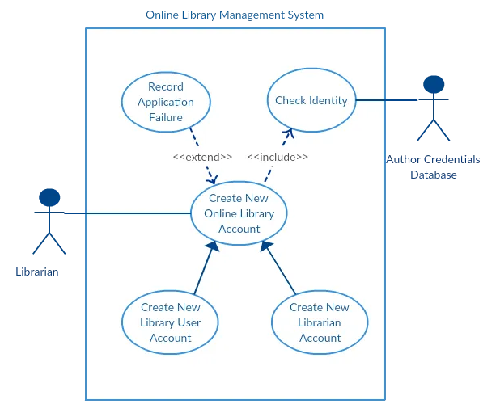

Slide 18
From the above use case diagram example of ‘Create New Online Library Account’, we will focus on the use case named ‘Create New User Account’ to draw our sequence diagram example.
Before drawing the sequence diagram, it’s necessary to identify the objects or actors that would be involved in creating a new user account. These would be;
Librarian
Online Library Management system
User credentials database
Email system

Slide 19
Once you identify the objects, it is then important to write a detailed description of what the use case does. From this description, you can easily figure out the interactions (that should go in the sequence diagram) that would occur between the objects above, once the use case is executed.
Here are the steps that occur in the use case named ‘Create New Library User Account’.
The librarian request the system to create a new online library account
The librarian then selects the library user account type
The librarian enters the user’s details
The user’s details are checked using the user Credentials Database
The new library user account is created
A summary of the new account’s details is then emailed to the user

Slide 20
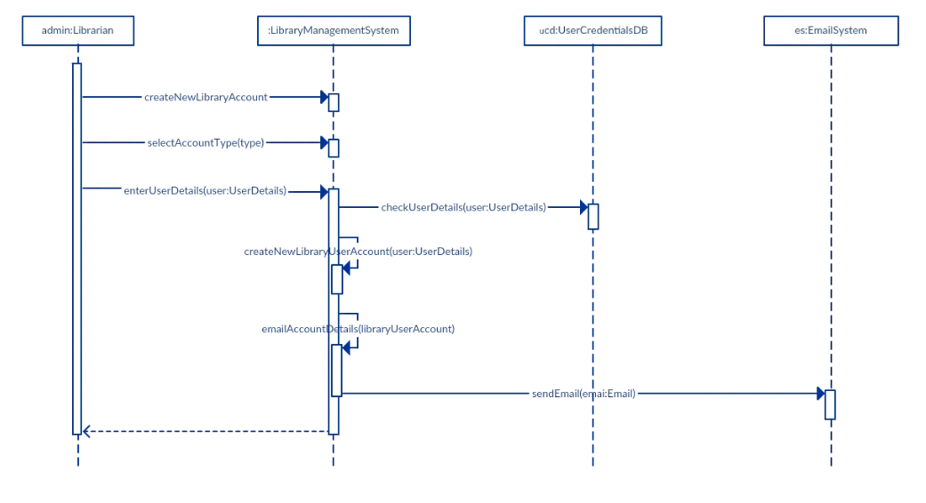

Slide 21
Collaboration Diagrams

Slide 22
Collaboration Diagrams
Class diagrams indicates what classes are part of our system, what they offer, how they relate, but they don’t tell us how they communicate.
Collaboration diagrams show (used to model) how objects interact and their roles.
They are very similar to sequence diagrams. Actually they are considered as a cross between class and sequence diagram.
Sequence Diagrams are arranged according to Time.
Collaboration Diagrams represent the structural organization of object.
[Both sequence and collaboration diagrams are called interaction diagrams]
Notes:
A collaboration diagram can also be considered as an extension of object diagram. In addition to the associations among objects, collaboration diagram shows the messages the objects send each other.
Messages among objects are represented with arrows that points to receiving object, near the association line between two objects.
Collaboration and sequence diagrams are interchangeable.
A label near the arrow shows what the message is.
The message typically tells the receiving object to execute one of its operations.
A pair of parentheses ends the message. Parameters are specified within parentheses.

Slide 23
Collaboration Diagram – URS Add Subject Scenario
1:parseCommand(cmd)
{transient}
<<self>>
procCmd(cmd)
u:URSDatabase
a:AddSubCmd
2:[if cmdN = ADDSUB]
AddSubCmd(u,cmdA)
{new}
3: execute()
<<local>>
3.2: addSubject(sub1)
3.1: Subject(id,name)
{new}
sub1:Subject

Slide 24
Collaboration Diagram – URS Add Subject Scenario
1:parseCommand(cmd)
<<self>>
procCommand(cmd)
u:URSDatabase
class URSDatabase{
private String cmdN;
private String cmdA;
private parseCommand(String cmd){
cmdN = ….
cmdA = ….
}
public procCommand(String cmd){
parseCommand(cmd);
}
}

Slide 25
Collaboration Diagram – URS Add Subject Scenario
{transient}
u:URSDatabase
a:AddSubCmd
2: AddSubCmd(u,cmdA)
{new}
class URSDatabase{
private String cmdN;
private String cmdA;
public procCommand(String cmd){
parseCommand(cmd);
if (cmdN == ADDSUB){
AddSubCmd a = new AddSubCmd(u,cmdA);
}
}
}

Slide 26
Collaboration Diagram – URS Add Subject Scenario
class abstract Command {
protected String cmd;
protected URSDatabase u;
public abstract void execute();
}
class AddSubCmd extends Command{
public AddSubCmd(URSDatabase urs, String cmd){
u = urs;
// parse command and set the arguments
}
public void execute(){
// implement here
}
}

Slide 27
Collaboration Diagram – URS Add Subject Scenario
3: execute()
a:AddSubCmd
u:URSDatabase
<<local>>
class URSDatabase{
private String cmd;
public procCommand(String cmd){
parseCommand(0);
if (cmd == ADDSUB){
AddSubcmd a = new AddSubCmd(……);
}
a.execute();
}
}

Slide 28
Collaboration Diagram – URS Add Subject Scenario
a:AddSubCmd
class AddSubCmd{
URSDatabase u;
public execute(){
subject sub1 = new Subject(id,name);
}
}
3.1: Subject(id,name)
sub1:Subject

Slide 29
Collaboration Diagram – URS Add Subject Scenario
u:URSDatabase
a:AddSubCmd
3.2: addSubject(sub1)
class AddSubCmd{
URSDatabse u;
public execute(){
subject sub1 = new Subject(……);
u.addSubject(sub1);
}
}

Slide 30
Collaboration Diagram – URS Add Subject Scenario
class URSDatabase{
private String cmd;
private Hashtable subjectHash = new HashTable();
public procCommand(String cmd){
parseCommand(0);
if (cmd == ADDSUB){
AddSubcmd a = new AddSubCmd(……);
}
a.execute();
}
public addSubject(Subject sub);
{
subjectHash.put(sub.getKey(), sub);
}
}

Slide 31
URS -High Level Class Diagram
URSDatabase
1
1
has
has
*
*
UniversityMember
Subject
0…10
0..3
AcademicStaff
Student
*
takes
1
teaches

Slide 32
Collaboration Diagrams
Collaborations Diagrams show transient links that exists between objects.
<<self>> - A message from object to itself
<< local>> - A message sent due to the object begin defined as a local variable in the method.
<<parameter>> - The object reference was sent as a parameter to the method.
<<global>> The object is global.
Notes:
A collaboration diagram can also be considered as an extension of object diagram. In addition to the associations among objects, collaboration diagram shows the messages the objects send each other.
Messages among objects are represented with arrows that points to receiving object, near the association line between two objects.
Collaboration and sequence diagrams are interchangeable.
A label near the arrow shows what the message is.
The message typically tells the receiving object to execute one of its operations.
A pair of parentheses ends the message. Parameters are specified within parentheses.

Slide 33
Use Case Vs Scenarios
Use case
Enroll Subject Use Case:
Scenario
Scenario 1 : Student is enrolled for the subject.
Scenario 2 : Enrollment fails since the student is already enrolled in 10 subjects.

Slide 34
Sequence Diagram – Enroll Student for subject successfully
u:URSDatabase
stu:Student
procCmd(cmd)
parseCommand(cmd)
{transient}
<< create >>
a:AssgSubCmd
execute()
AssgSubCmd(u,cmdA)
getStudent(id)
return stu
getSubject(subId)
return sub
[if stu != NULL and sub != NULL]
addSubject(sub)

Slide 35
Collaboration Diagram – Enroll Student in Subject Scenario
1:parseCommand()
{transient}
<<self>>
procCmd(cmd)
2:AddSubCmd(u,cmdA)
a:AssgSubCmd
u:URSDatabase
3: execute()
{new}
<<local>>
3.1: stu: =getStudent(id)
3.2: sub: = getSubject(subId)
3.3: [stu !=NULL and
sub!= NULL]:
addSubject(sub)
{parameter}
stu:Student

Slide 36
Collaboration Diagram – Enroll Student in Subject subject - implementation
procCmd(cmd)
{transient}
u:URSDatabase
3: execute()
{new}
a:AssgSubCmd
<<local>>
3.1: stu: =getStudent(id)
3.2: sub: = getSubject(subId)
class AssgSubCmd{
private URSDatabase u;
public execute(){
Student stu = u.getStudent(id);
Subject sub = u.getSubject(subId);
if (stu != null && sub != null){
stu.addSubject(sub);
}
}
}
3.3: [stu !=NULL and
sub!= NULL]:
addSubject(sub)
{parameter}
stu:Student

Slide 37
Sequence Diagram – Enroll Student for subject - Failure
u:URSDatabase
stu:Student
procCmd(cmd)
parseCommand()
{transient}
<< create >>
a:AssgSubCmd
execute()
AssgSubCmd(u,cmd)
[if stu != NULL
and sub != NULL]
getNumSubjects()
addSubject(sub)
return num
[num >= 10]
Excp
return e

